Slide 1


Project idea –
Fast-Fashion
Jasmin Runge & Kim Lea Hess
Notes:
Welcome to the presentation about our project idea, fast-fashion.

Slide 2
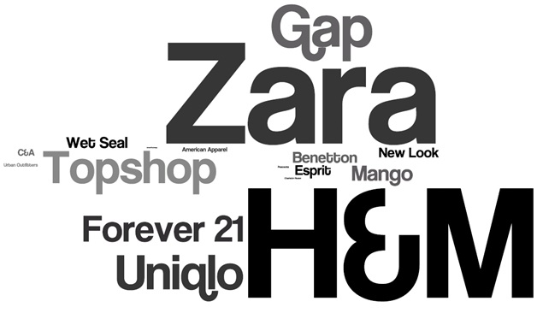
Fast- Fashion
Zaful
Shein
Wish

Slide 3


Differences

Slide 4



Survey
Deutsch
ไทย

Slide 5
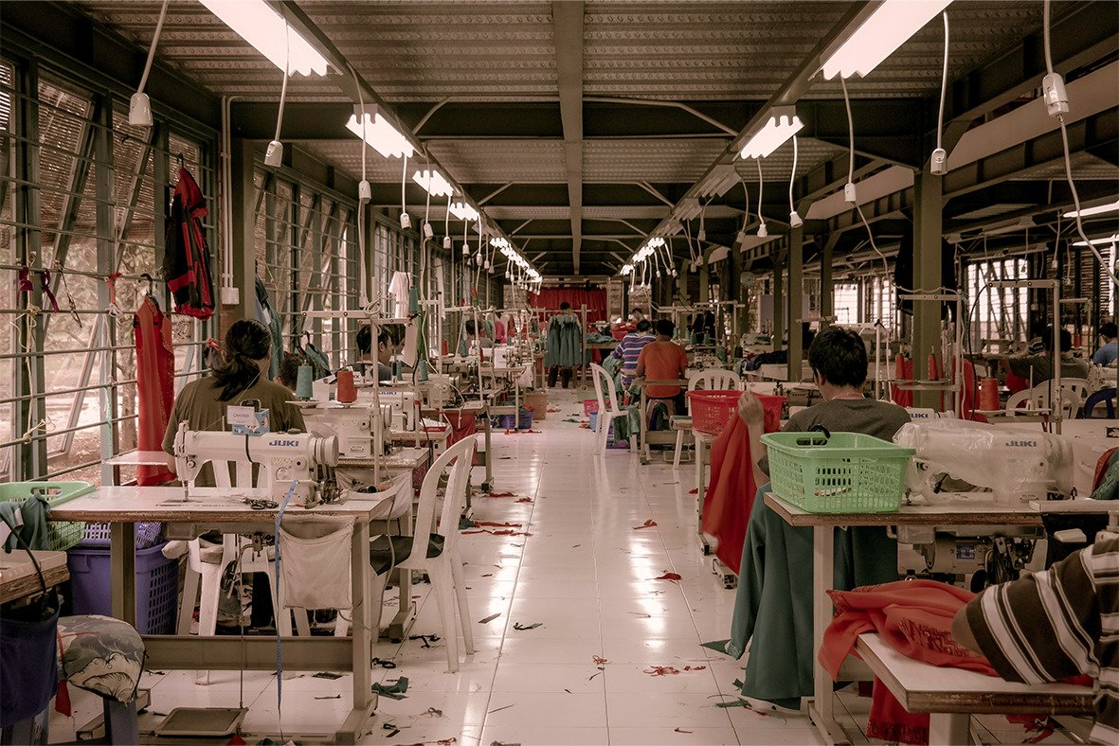
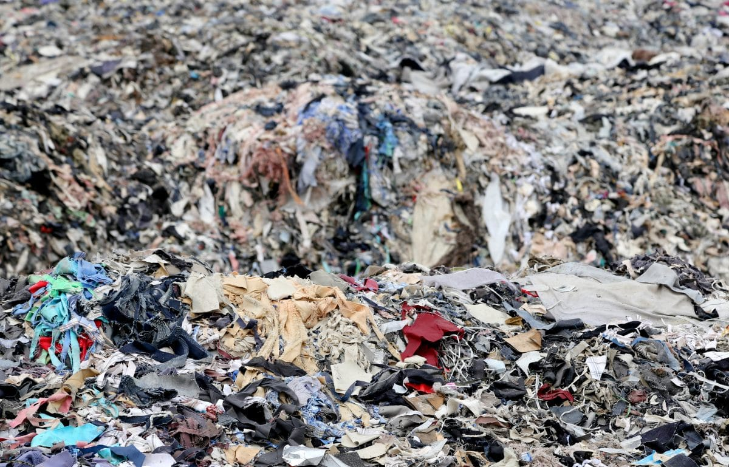
Impact on the enviroment

Slide 6

Thank you for your attention!

